Slide 1
All meetup data is here
All Data at https://github.com/NanoDataCenter/nano_data_center
MIT License
Use it free and share

Slide 2
New IOT
New Architecture
New Developer
New Technician

Slide 3
New IOT Architecture
Developing IOT systems is a two tier approach.
Embedded Side
Develop Sensors
Develop Embedded Devices
Power Constraints
Communications Constraints
Cloud/ Networking Side
Provide Connectivity to Internet
Provide Service to Remote Users
Provide Remote Control of Embedded Devices
Provide Services for Monitoring and Debugging Remote Devices

Slide 4
Need to do it with few people
Many successful online companies worth 100’s million of dollars have been built with crews as low as 4.
Productive people is as the sqrt( N )
For a group of 10 (3) are productive
For a group of 100 (10) are productive
This means the members of your team must be multifunctional.
Renaissance Men?
Purpose of this meetup is to present tools so that a small group can construct state of the art IOT systems.
Concentrate on OEM type systems.
Numbers ( 1-100 ) for specialty systems
Cannot compete with large consumer systems.
For larger numbers a larger company will come into play, ie, buy out.

Slide 5
Rules of OEM IOT Devices
The customer will want to add more functions
You want that
There is usually only one feature that triggers the buy.
Varies with customer and is hard to predict
The OEM device that is developed need to be adaptable to multiple uses and customers.
The result is that these systems will be more complicated than single use devices.
IOT systems need to handle many loosely independent activities.

Slide 6
Layout of System
Cloud Data Center
Data Center Type
Development
Raspberry Pi
Nano Data Center
Slave Device 1
Slave Device 2
Slave Device N
Embedded Development

Slide 7
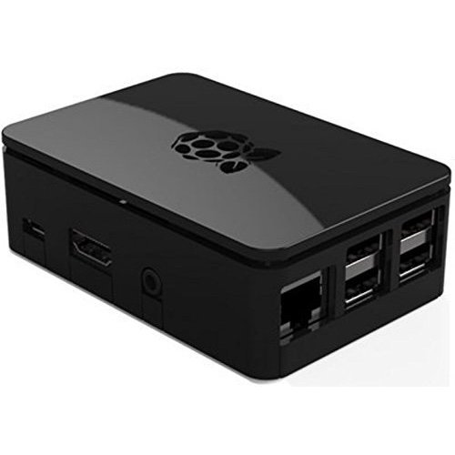
Role of Nano Data Center Functions are added to an existing platform much like apps are to a cell phone
Local Graph
System Graph
Edge Device is a Nano Data Center
Cloud Interface
AMQP or
equivalent
Device Data
Base
Event Bus
Local Apps
Local
Web Pages
Local Web
Sockets
Cloud Apps

Slide 8
Role of Technicians
Unlike Developers, Technicians need to be created very quickly.
Role of Technicians
Assemble and Install Units
Configure Units
Run Diagnostics and do servicing.
Ideally the end users should be the technicians or “lite technicians”.
Without organic technicians, the following results
High paid consultants or consulting services
Law suits from unhappy customers

Slide 9
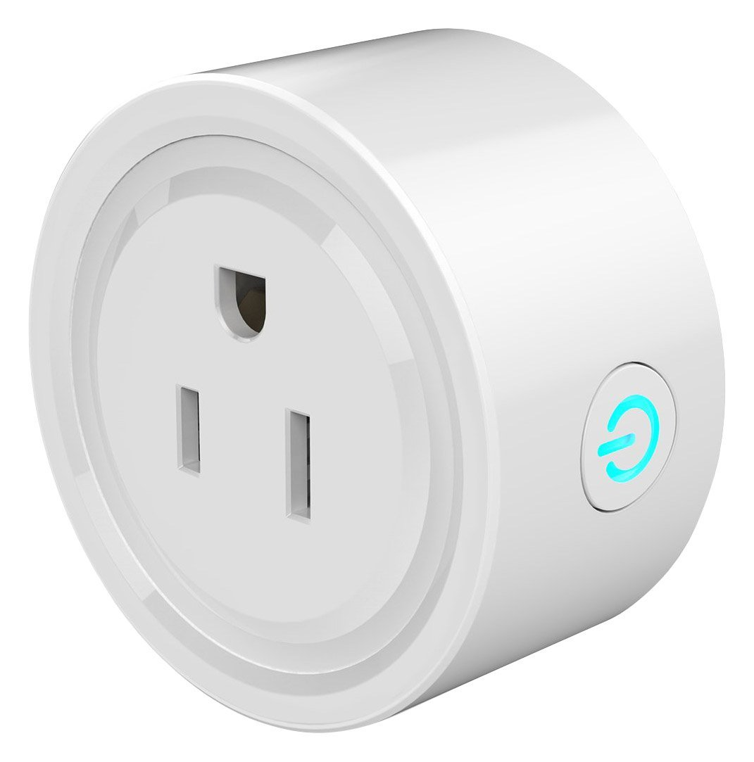
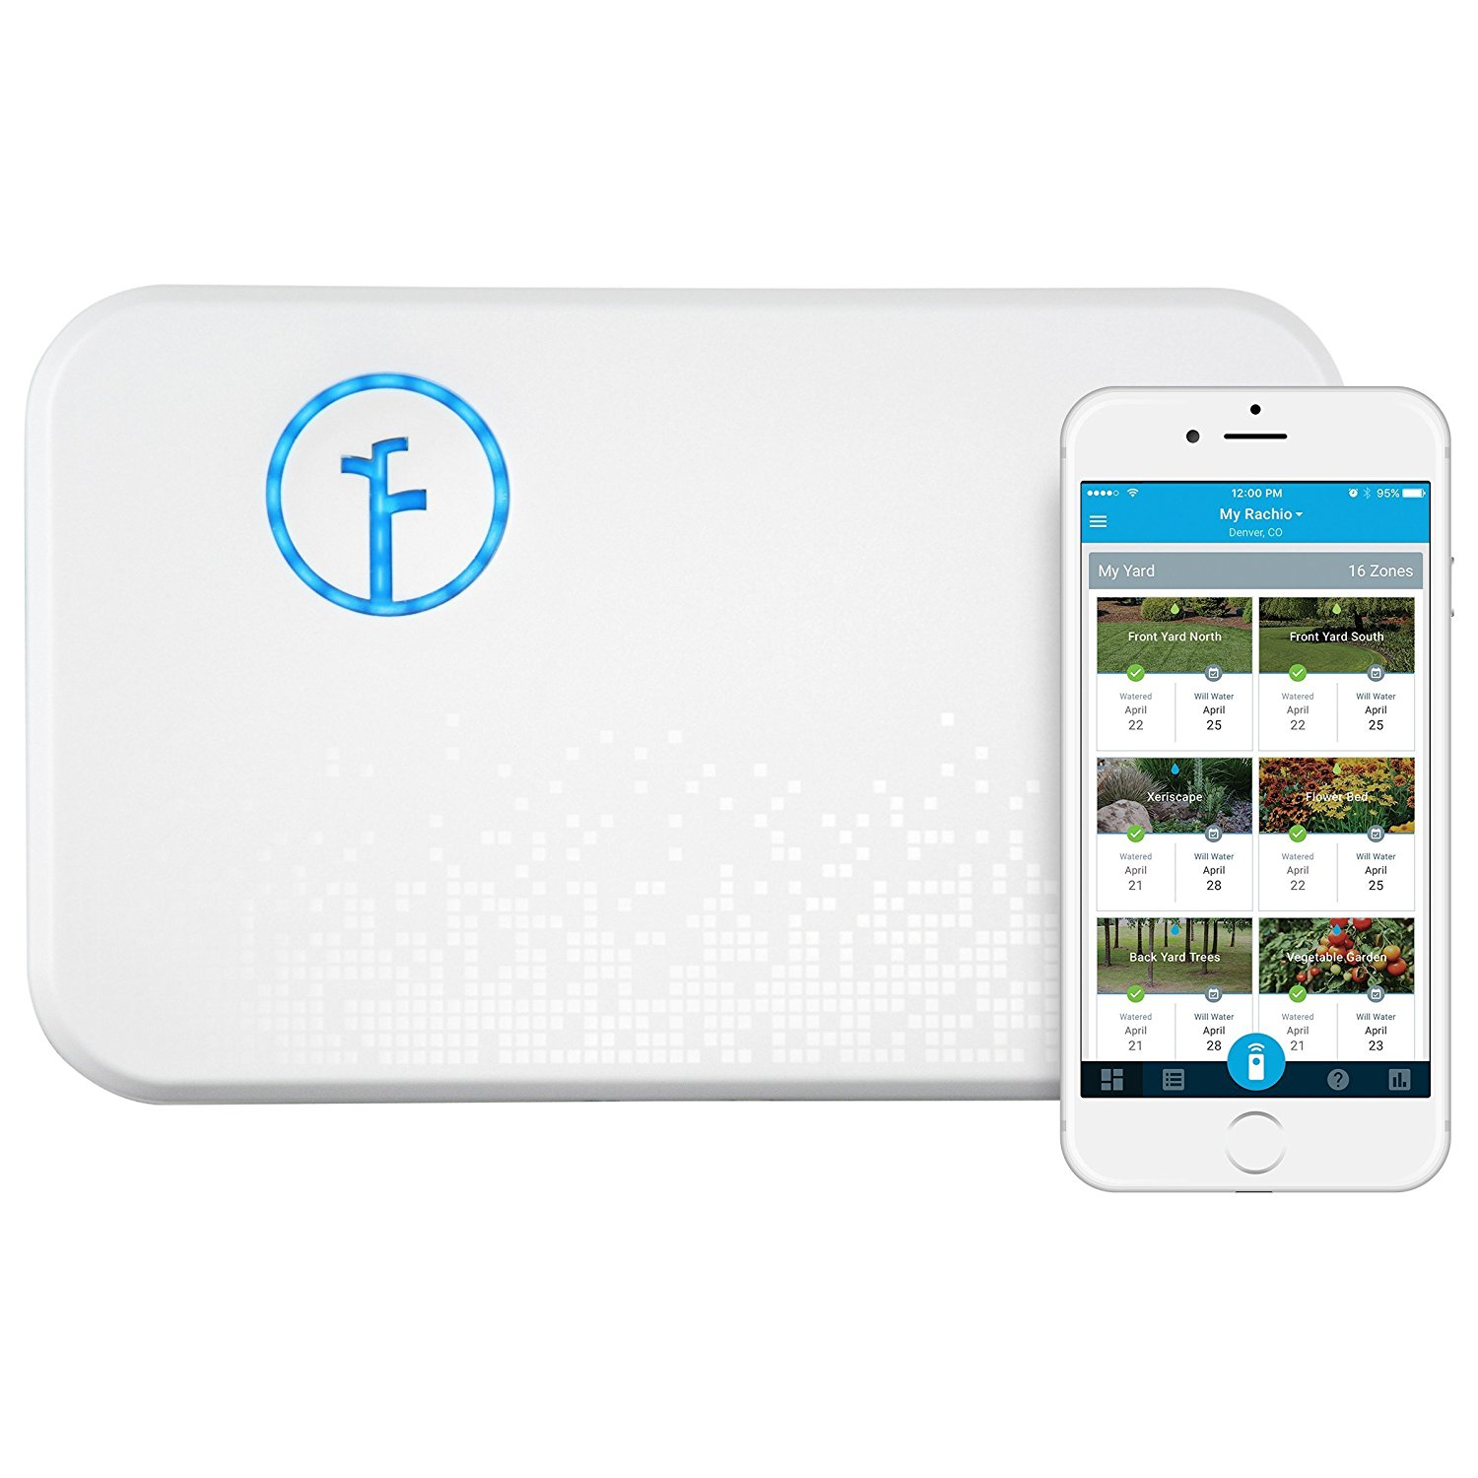
These products require customer technicians

Slide 10
Three Tracks
Nano Data Center Track
Embedded Track
This section is concerned with the concept behind data centers and the software that is used in the is used in the Nano Data Center.
After the Nano Data Center, the IOT infrastructure will be presented.
All IOT projects are welcome to being discussed. Our first task will be to turn the vending machine shell to an IOT vending machine
The project will be run like as a company would design and put the unit into production.
Areas such manufacturing and servicing will be addressed

Slide 11
Third Track
The third track is a lab track. The purposes of this track are:
Provide Practical Experience
Provide a document trail to train people.
Provide a document trail to start companies.
The lab track will be taught through projects.
The first project is the IOT vending machine.

Slide 12
Nano Data Center Track
What are the Pieces in a Data Center
Redis as the basis of the Nano Data Center
Graphical Data Bases
Logs and Text Search
Web Backend and Web Frontend Basics – Need help on modern frame works
Application or process support
Docker Integration
Alexa Integration
Phone Integration??? -- Cannot Teach this one
Phone Apps
IOT setup thru bluetooth
Start Cloud Track

Slide 13
Embedded Track
Rules of the Game
Get Prototype out as fast as possible
Minimize NRE
Develop as little as possible
Types of IOT Environments
State of Power
Electrical Power
No Electrical Power
Internet Communication
Internet Connectivity
Cell Phone Connectivity
No Cell Phone Connectivity
Mesh Networks and LoRa

Slide 14
Embedded Track Continued
Selection of Processors and Architectures
Packaging for deployment
Introduction to PLC’s
Introduction to pi zero w as an IOT device
Introduction to ESP32 as on IOT device
Micropython , Audrino, or Lua which is the best environment?
Embedded Software Development techniques

Slide 15
Suggestions for Improvements to Meetup
Any Ideas?

